Slide 1
Semi-Indexing Semi-Structured Data
(in tiny space)
Giuseppe Ottaviano
Roberto Grossi
(Università di Pisa)

Slide 2
Map
{"timestamp": "2006-04-03 21:31:35", "user": "1578922", "query": "londn news"}
{"timestamp": "2006-04-08 14:09:27", "user": "18214495", "query": "craigslist"}
{"timestamp": "2006-04-17 22:31:50", "user": "13113868", "query": "facebook"}
{"timestamp": "2006-04-18 23:15:55", "user": "4993974", "query": "music sites"}
{"timestamp": "2006-04-26 22:09:39", "user": "2073646", "query": "ny lottery"}
{"timestamp": "2006-04-27 22:47:36", "user": "1871400", "query": "fancy clothes"}
{"timestamp": "2006-05-08 22:29:11", "user": "16466870", "query": "deviant art"}
{"timestamp": "2006-05-15 11:13:36", "user": "583879", "query": "24 hour fitness"}
{"timestamp": "2006-05-19 22:35:56", "user": "884408", "query": "dictionary"}
{"timestamp": "2006-05-27 23:45:49", "user": "7169518", "query": "free online games"}
... ...
2006-04-03 21:31:35
2006-04-08 14:09:27
2006-04-17 22:31:50
2006-04-18 23:15:55
2006-04-26 22:09:39
2006-04-27 22:47:36
2006-05-08 22:29:11
2006-05-15 11:13:36
2006-05-19 22:35:56
2006-05-27 23:45:49
Notes:
Parsing overhead negligible

Slide 3
{"timestamp": "2006-04-03 21:31:35", "user": "1578922", "query": "londn news"}

Slide 4
{"timestamp": "2006-04-03 21:31:35", "user": "1578922", "spelled": "london news", "query": "londn news"}

Slide 5
{"spelled": "london news", "timestamp": "2006-04-03 21:31:35", "results": [{"url": "http://www.bbc.co.uk/london/"}, {"url": "http://www.thisislondon.co.uk/standard/"}, {"url": "http://www.telegraph.co.uk/"}, {"url": "http://en.wikipedia.org/wiki/List_of_newspapers_in_London"}, {"url": "http://www.abyznewslinks.com/ukinglo.htm"}, {"url": "http://www.thetimes.co.uk/tto/news/"}, {"url": "http://www.thesun.co.uk/sol/homepage/"}, {"url": "http://www.world-newspapers.com/london.html"}, {"url": "http://www.thelondonnews.net/"}, {"url": "http://www.guardian.co.uk/uk/2011/aug/08/london-riots-spread-second-night"}], "user": "1578922", "query": "londn news"}

Slide 6
{"timestamp": "2006-04-03 21:31:35", "results": [{"url": "http://www.bbc.co.uk/london/", "title": "BBC News - London"}, {"url": "http://www.thisislondon.co.uk/standard/", "title": "London News | London Evening Standard - London's newspaper"}, {"url": "http://www.telegraph.co.uk/", "title": "Telegraph.co.uk - Telegraph online, Daily Telegraph and Sunday ..."}, {"url": "http://en.wikipedia.org/wiki/List_of_newspapers_in_London", "title": "List of newspapers in London - Wikipedia, the free encyclopedia"}, {"url": "http://www.abyznewslinks.com/ukinglo.htm", "title": "London Newspapers - London Newspaper & News Media Guide"}, {"url": "http://www.thetimes.co.uk/tto/news/", "title": "The Times | UK News, World News and Opinion"}, {"url": "http://www.thesun.co.uk/sol/homepage/", "title": "The Sun | The Best for News, Sport, Showbiz, Celebrities | The Sun"}, {"url": "http://www.world-newspapers.com/london.html", "title": "London Newspapers"}, {"url": "http://www.thelondonnews.net/", "title": "London Calling | News Headlines from The London News.Net"}, {"url": "http://www.guardian.co.uk/uk/2011/aug/08/london-riots-spread-second-night", "title": "London riots spread south of Thames | UK news | guardian.co.uk"}], "user": "1578922", "spelled": "london news", "query": "londn news"}

Slide 7
{"spelled": "london news", "timestamp": "2006-04-03 21:31:35", "results": [{"url": "http://www.bbc.co.uk/london/", "title": "BBC News - London"}, {"url": "http://www.thisislondon.co.uk/standard/", "title": "London News | London Evening Standard - London's newspaper"}, {"url": "http://www.telegraph.co.uk/", "title": "Telegraph.co.uk - Telegraph online, Daily Telegraph and Sunday ..."}, {"url": "http://en.wikipedia.org/wiki/List_of_newspapers_in_London", "title": "List of newspapers in London - Wikipedia, the free encyclopedia"}, {"url": "http://www.abyznewslinks.com/ukinglo.htm", "title": "London Newspapers - London Newspaper & News Media Guide"}, {"url": "http://www.thetimes.co.uk/tto/news/", "title": "The Times | UK News, World News and Opinion"}, {"url": "http://www.thesun.co.uk/sol/homepage/", "title": "The Sun | The Best for News, Sport, Showbiz, Celebrities | The Sun"}, {"url": "http://www.world-newspapers.com/london.html", "title": "London Newspapers"}, {"url": "http://www.thelondonnews.net/", "title": "London Calling | News Headlines from The London News.Net"}, {"url": "http://www.guardian.co.uk/uk/2011/aug/08/london-riots-spread-second-night", "title": "London riots spread south of Thames | UK news | guardian.co.uk"}], "related": ["London Sun Newspaper", "London Times Newspaper", "London England Newspapers", "Guardian Newspaper London", "London Daily Mirror", "London Daily News", "London Paper", "London Herald"], "user": "1578922", "query": "londn news"}
Loading/Parsing overhead not negligible anymore
Notes:
Curse of denormalization!

Slide 8
Scenario
Large collections of records
Semi-structured textual format
  JSON, XML, …
MapReduce-like processing

Slide 9
Switch to binary
JSON/XML/…
Binary
format
Need architecture change, lose benefits of textual formats

Slide 10
Our proposal: semi-index
JSON/XML/…
Semi-index
Data is left unchanged
A structural index is created on a different file
Existing consumer can just ignore it
Small overhead

Slide 11
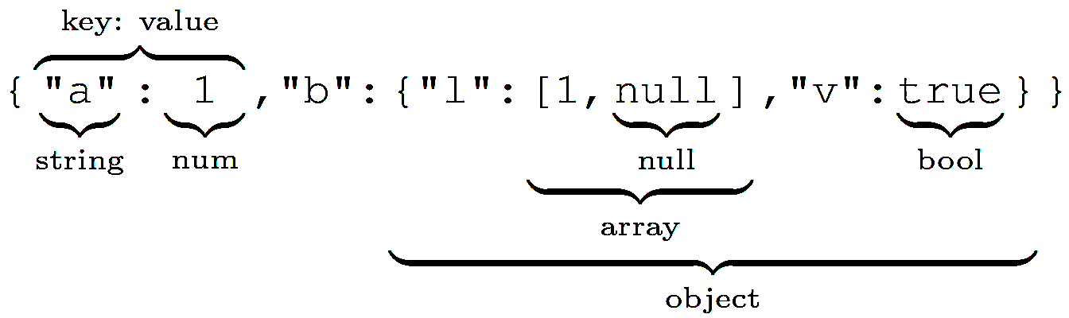
JSON recap
a = 1
b.l[1] = null
B.v = true

Slide 12
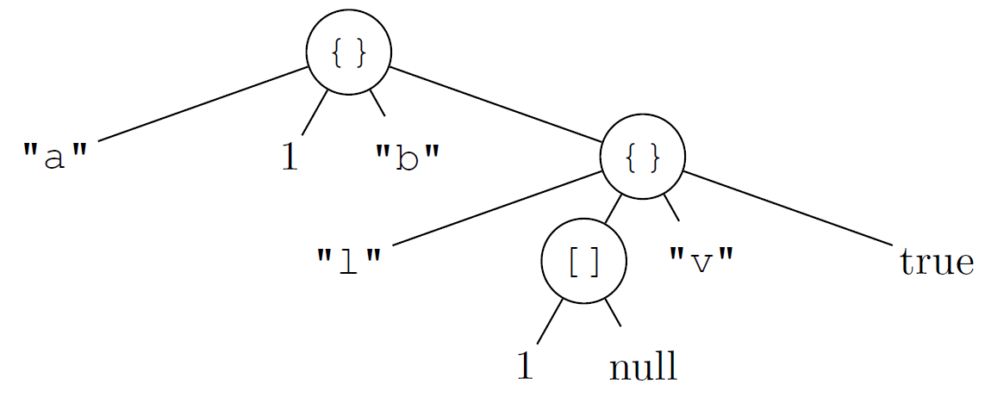
Standard parsing
Deserialized tree memory >> JSON size

Slide 13

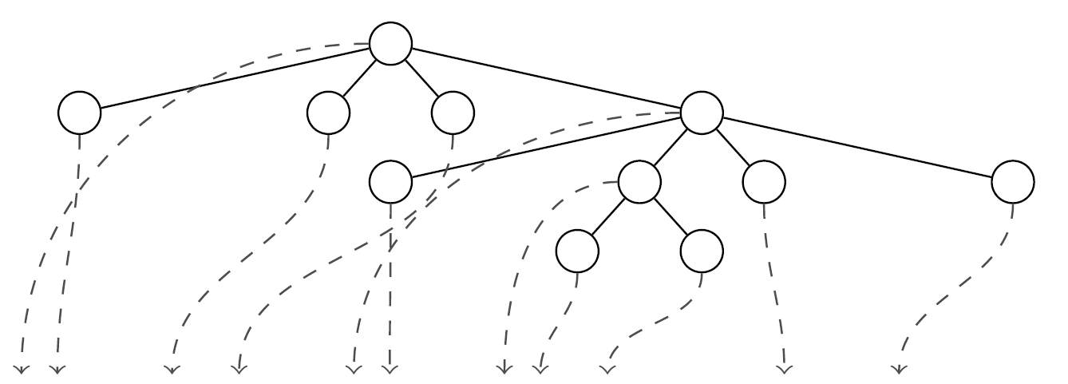
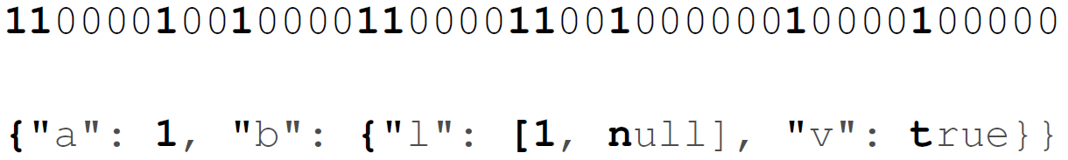
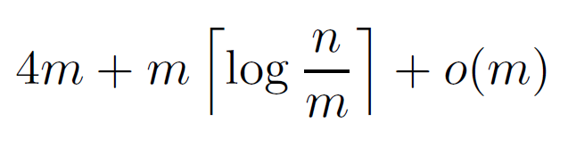
Semi-Index
Tree structure: Balanced Parentheses (BP)
Positions: Elias-Fano sequence
Total space (in bits):
Applicable to JSON, XML, …
Notes:
The three is what some XML parsers call “lazy parsing”. At least 3 pointers per node

Slide 14
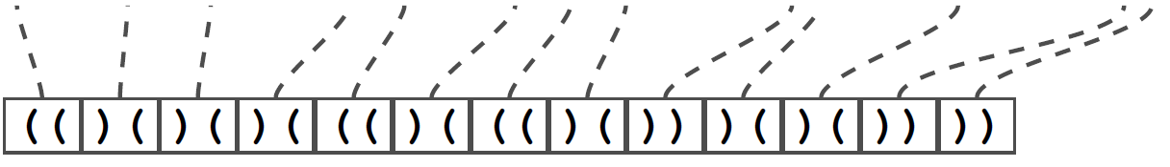
JSON-specific semi-index
POS: 1 for “structural chars” {}[],: and 0 otherwise
BP : pair of parentheses for each structural char
  (( for { and [
  )) for } and ]
  )( for , and :
POS
BP
Notes:
JSON already has a nice nested parentheses structure, we can exploit it

Slide 15
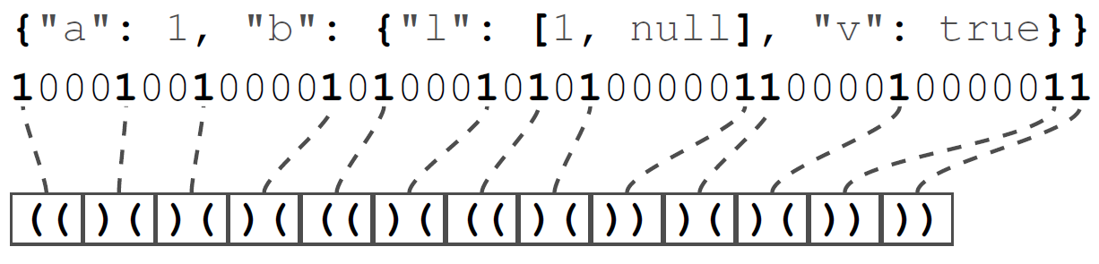
Query b.l[1]
Semi-index is small: can be loaded in memory
Skipped values can be arbitrarily large: save I/O
Support all navigational operations
Notes:
BP and POS have constant time operations!
Navigational operations: i-th child, binary search

Slide 16
Performance (Wikipedia)
Task
  Wikipedia dataset (many long strings)
  Extract 4 fields from each document
Standard parsing
  Extraction: 53.5 seconds
BSON
  Conversion: 155.8 (only once)
  Extraction: 50.3 seconds
Semi-index
  Construction: 31.9 seconds (only once)
  Extraction: 10.6 seconds
  Extraction (compressed): 4.7 seconds
  Semi-index space overhead: ~0.4%

Slide 17
Performance (XMark)
Task
  XMark dataset (high node density)
  Extract 4 fields from each document
Standard parsing
  Extraction: 154.5 seconds
BSON
  Conversion: 246.9 (only once)
  Extraction: 28.3 seconds
Semi-index
  Construction: 38.9 seconds (only once)
  Extraction: 40.2 seconds
  Extraction (compressed): 15.9 seconds
  Semi-index space overhead: ~10%

Slide 18
Other applications
Alternative to lazy parsing
Parsing in memory-constrained devices

Slide 19
Thanks for your attention!
Questions?

